Slide 1


Census 2020
Online Questionnaire Assistance Guide
Notes:
This guide provides an overview of the online 2020 Census, guidelines for making devices available to the public to respond, and assisting residents with the questionnaire. Please checkout the slide’s note section for additional information and online resources.

Slide 2
Overview
Census 2020 Impact
Guidelines for Online Census Support
Assisting with Responses
How to Access the Online 2020 Census
2020 Census Questions
Tracking Your Community’s Progress
SLC Counts Resources

Slide 3

Introduction
Stakeholders can support the census in new ways by making electronic devices available to the public to respond.
Guidelines are in place for stakeholders to support a safe and inclusive census.
  Only the Census Bureau can offer confidentiality protected by law.
Stakeholders are discouraged from conducting surveys during the 2020 Census so your surveys aren’t confused with the census.
Partners can provide incentives to respondents for attending a census event and self-responding to the census.
Notes:
While stakeholders are spending significant resources on the census may want to gauge their efforts’ impact, stakeholders are discouraged from conducting surveys during the 2020 Census so your surveys aren’t confused with the census.

Slide 4
Impact!
Addressing the digital divide.
Supporting non-English speakers by accessing the 2020 Census in 12 different languages.
Providing access to a computer in a familiar and trusted space.
Fair and Inclusive Count
  Avoiding door-to-door enumeration which isn’t as accurate and is expensive.
Notes:
Impact = greater participation!

Slide 5

Census 2020 Overview
The decennial census is the most inclusive civic activity in our country, covering every person in every household.
Mandated by the U.S. Constitution in 1790 (Article I, Section 2).
April 1 is Census Day, a key reference date for the 2020 Census. When completing the census, you will include everyone living in your home on April 1, 2020.
  Census runs March 12 - October 31, 2020
Notes:
Salt Lake City is not in charge of conducting the census or hiring for census jobs. SLC is working in partnership with the Census Bureau to ensure all residents are counted in the 2020 Census
2020 Census Info: https://2020census.gov/en/what-is-2020-census.html?cid=20394:%2Bwhat%20is%20%2Bcensus:sem.ga:p:dm:en:&utm_source=sem.ga&utm_medium=p&utm_campaign=dm:en&utm_content=20394&utm_term=%2Bwhat%20is%20%2Bcensus

Slide 6

Impact on Utah
Census data determines Utah's seats in the U.S. House of Representatives, how much federal funding our states receives, and our communities access to public schools and hospitals.
  Every person not counted in Utah is a loss of $1,860 per year over the next 10 years.
  That’s $18,600 per person over ten years!

Slide 7
Undercounted Populations
Racial and ethnic minorities
Persons who do not speak English fluently
Lower income persons/renters
Homeless persons
Undocumented immigrants
Young mobile persons
Children (ages 0-4)
Persons who are angry at and/or distrust the government
LGBTQ persons
College students
Notes:
An undercount in the census means federal dollars and representation go to a smaller number of people.
Undercounted populations have low census response rates because they’re hard to locate, hard to contact or hard to persuade to complete the census.

Slide 8

Call to Action!
Provide access to computers and tablets for on-the-spot access to the 2020 Census website.
    my2020census.gov
Talk about the 2020 Census! Distribute content on your social media accounts, in your newsletters, on your website or hang up a poster.
Please report misinformation and disinformation to rumors@census.gov.

Slide 9
Guidelines
Online Census Support
Notes:
Guidelines for online census support through a computers/laptops/iPads

Slide 10
Guidelines
Make clear that you are not an employee or representative of the Census Bureau.
Do not use the Census Bureau’s logo or other branding in any way when making devices available for response. You may use your logo.
Wifi connection must require a password to access it.
Secure Environment: Ensure the environment where the devices are is private, and that responses cannot be seen by anyone.
  Use a privacy screen protector or create a private space.
Software updates are installed on devices.
Link directly to my2020census.gov. Do not create a creative interface to respond.

Slide 11
Guidelines Continued
7. Do not collect response information from outside the Census Bureau’s online form. For example, do not gather information on paper and later enter it in the Census Bureau’s online response website yourself.
TIPS:
Internet Browsers: Best are Internet Explorer, Edge, Chrome, Safari, Firefox, and Samsung Native
Multiple Response From a Single Location: The Census Bureau has implemented secure systems that effectively prevent invalid responses without rejecting multiple responses from a single IP address.

Slide 12
And now… a word from the Census Bureau:
The Census Bureau cannot and does not protect any devices that you make available to the public for response. The Census Bureau has no responsibility for the operation, maintenance, or security of any such device or any systems or networks supporting the device. The Census Bureau is not responsible for providing device, systems or network support, and is not responsible for any failures of those devices, systems, or networks. Therefore, any entity making devices available to the public should follow best practices for securing devices and networks. The Department of Homeland Security’s Cybersecurity and Infrastructure Security Agency’s Web site provides steps to secure devices.
Notes:
Homeland Security’s Cybersecurity and Infrastructure website: https://www.us-cert.gov/ncas/tips

Slide 13
Assisting with Responses

Slide 14
Assisting People with Their Responses:
If a member of the public requests assistance in completing their questionnaire, direct them to the response option (online, phone, mail/paper, census taker visit to the home) that best suits their needs.
  For example, if an individual is responding online and needs language assistance, or if a person who is blind requests help with the online response website, encourage them to respond through the phone response option.
Notes:
Census Questionnaire Assistance Numbers: https://www.census.gov/programs-surveys/decennial-census/2020-census/planning-management/memo-series/2020-memo-2019_18.html

Slide 15
Exception
If a respondent insists that you help them, inform them that you are not a employee or representative of the Census Bureau and therefore their answers are not protected by law with you.
Do not encourage anyone to respond to the census on behalf of a household in which they do not live.
Notes:
Do not lead respondents to believe you are covered by Title 13 Confidentiality law, as only sworn Census Employees have this status.

Slide 16

Tips
Encourage individuals to respond on their own and don’t watch them enter their responses.
Provide examples of how you would answer a question instead of asking for personal details.
  Examples can be hypothetical.
Never assume, don’t tell people how to self-identify.
Notes:
Questionnaire Assistance Support Numbers: https://www.census.gov/programs-surveys/decennial-census/2020-census/planning-management/memo-series/2020-memo-2019_18.html

Slide 17
Contact Info
Census Bureau
Questionnaire Assistance Phone Numbers:
  English: 844-330-2020
  Spanish: 844-468-2020
  TDD: 844-467-2020
  TTY: For people who are deaf or hard of hearing call 1-800-877-8339 to use the Federal Relay Service.
NALEO Bilingual Census Information Hotline
Monday - Friday: 8:30am - 8:30pm ET
877-EL-CENSO (877-352-3676)
Text “Census” to 97779
Notes:
Bilingual Census Information Hotline is free, anonymous and provides a fully trained bilingual staff and trusted messengers ready to answer all the census-related questions for the Latino community.
Questionnaire Assistance Numbers: https://www.census.gov/programs-surveys/decennial-census/2020-census/planning-management/memo-series/2020-memo-2019_18.html

Slide 18

Safe Census
Emphasize that the 2020 Census is safe and secure.
From the moment responses are submitted, they are protected by sophisticated security measures that meet federal government cyber security standards.
Personal information is confidential. It can never be shared with law enforcement agencies, ICE or a landlord.

Slide 19
How To Access The Online Census
ID Requirements & Language Support
Notes:
This training specifically focuses on online support
Ways to Participate in Census 2020
Online (compatible with mobile devices)
By phone
By mail
Enumerator (in-person response)

Slide 20
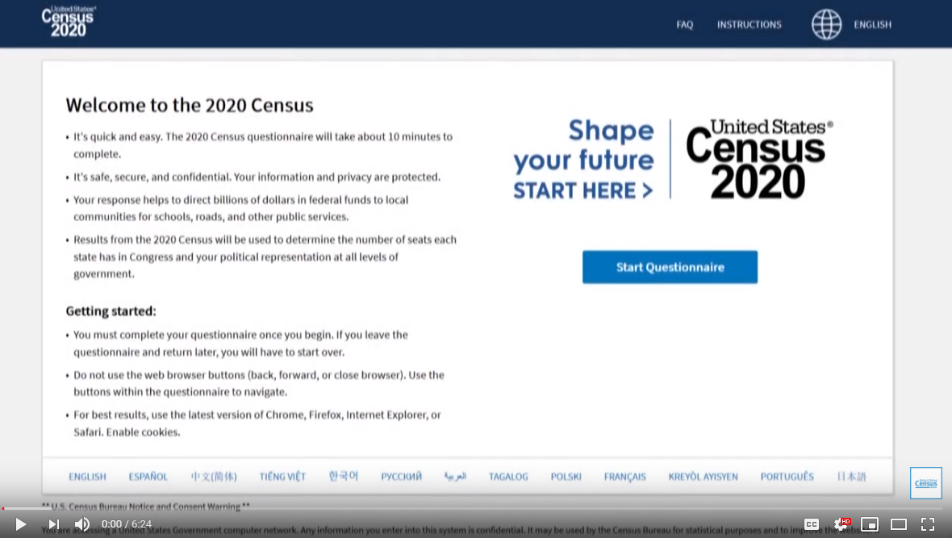
Preview of the online 2020 Census
https://www.youtube.com/watch?v=fXg1_1HHKzA&feature=youtu.be
Notes:
The online 2020 Census can be accessed at: my2020census.gov
Watch on YouTube: https://www.youtube.com/watch?v=fXg1_1HHKzA&feature=youtu.be

Slide 21
Steps
Select language first
Use Unique ID Number (which the Census Bureau will mail households) or Non-ID Response (which is based on address).
Person 1 answers 9 questions
  Should take less than 10 minutes!
The entire survey must be completed in one session. You cannot start it, save your work and come back later.
There is a 15 minute timeout for security purposes - if the survey has been started and activity goes dormant, the respondent will be logged out and have to re-start the process again. Users are warned at 13 minutes that they will be logged out if no activity is taken.
Notes:
Q&A: https://2020census.gov/en/about-questions.html?cid=20009:%2Bcensus%20%2Bquestionnaire:sem.ga:p:dm:en:&utm_source=sem.ga&utm_medium=p&utm_campaign=dm:en&utm_content=20009&utm_term=%2Bcensus%20%2Bquestionnaire
2020 Census Questionnaire Example:
https://ww
w2.census.gov/programs-surveys/decennial/2020/technical-documentation/questionnaires-and-instructions/questionnaires/2020-informational-questionnaire.pdf

Slide 22

Online Languages
English
Spanish
Chinese
Vietnamese
Korean
Russian
Arabic
Tagalog
Polish
French
Haitian Creole
Portuguese
Japanese
Notes:
Before you start the online questionnaire - you must select a language (13 languages to choose from).

Slide 23
Accessing Language Guide
If a respondent requires a language that is not available on the online Census, there are video and printed guides offered in 59 other languages.
Video language guides will help respondents complete the 2020 Census online.
Print language guides will help respondents complete the 2020 Census paper questionnaire.
Access the Language Video and Printer Guides HERE
Notes:
If someone doesn’t speak one of those 13 languages that is available online, there is language glossaries in 59 non-English languages. Please help respondents print them out if required.
GUIDES CAN BE PRINTED HERE: https://www.census.gov/programs-surveys/decennial-census/2020-census/planning-management/language-resources.html

Slide 24
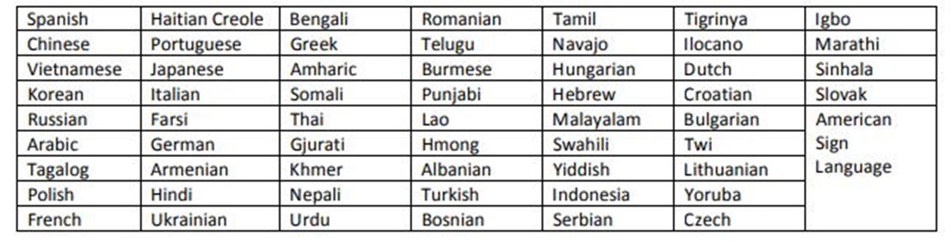
59 non-English Languages Guides Available In:

Slide 25
Unique ID Number
ID Response: The Census Bureau will be mailing out a postcard that contains a unique Census ID number made up of letters and numbers that is linked to a specific address.
  When respondents pull up the form online, they will be prompted to input their ID code.
  The code is for one use only.
  If a respondent, does not complete the online process and is timed-out, the respondent will need to sign back in using the same unique Census ID number to fill out the questionnaire from the beginning.
  Once a respondent completes their online questionnaire and submits their response, the code will no longer be valid. Should a respondent need to re-do their Census form they will have to use the non-ID path.
Notes:
After language is selected - the questionnaire will ask for a “Unique ID Number”
A Unique ID number is preferred but not required. It is preferred in order to assure the Census Bureau gets a response from every housing unit. It helps avoid the Census Bureau visiting a house in person since each ID number is uniquely linked to a housing structure on the ground.

Slide 26
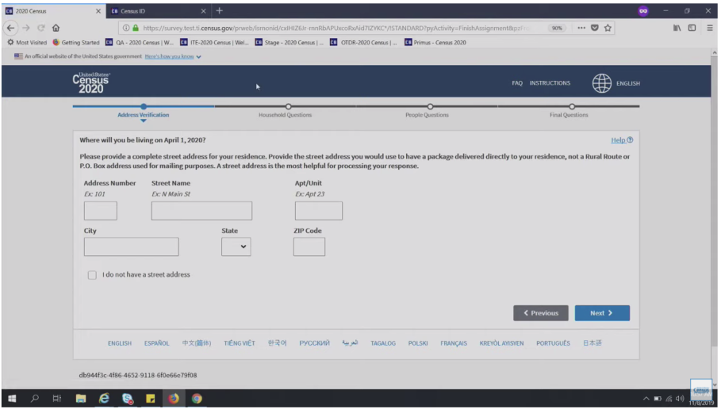
Non-ID Response
If respondents do not have an ID number, they will still be able to respond. To do this, they will need to select the option for “Non-ID Response”. They will be asked for their address.
If they don’t have a city style address, they will be asked several location/description questions.

Slide 27

Unsure If You Have Been Counted?
If people express to you that they are unsure if others in their home completed the 2020 Census and included them, you should advise them to complete the 2020 Census on their own and include everyone living in their household (children, non-relatives, and other families).
  The Census Bureau has processes in place to resolve duplicate submissions.

Slide 28
2020 Census Questions
Notes:
Questions Asked: https://2020census.gov/en/about-questions.html?cid=20009:%2Bcensus%20%2Bquestionnaire:sem.ga:p:dm:en:&utm_source=sem.ga&utm_medium=p&utm_campaign=dm:en&utm_content=20009&utm_term=%2Bcensus%20%2Bquestionnaire
2020 Census Questionnaire Example:
https://www2.census.gov/programs-surveys/decennial/2020/technical-documentation/questionnaires-and-instructions/questionnaires/2020-informational-questionnaire.pdf

Slide 29
2020 Census Questions & Why They’re Asked
Names
  To ensure that each household member is counted only once.
How many people are living or staying at your home on April 1, 2020
  Census data helps us recognize important trends in our society, such as whether young adults are living with their parents or moving in with roommates.
Relationship of each person in your home
  On the questionnaire, “Person 1” is the “reference person” for the household. Person 1 completes the census and indicates their relationship to everyone in the household.

Slide 30
2020 Census Questions & Why They’re Asked
Whether the home is owned or rented
  This generates statistics about homeownership and renting to see how the nation’s economy is doing. The data also informs where new houses are built.
Sex
  Each individual is asked to identify as either male or female. The data is used to enforce rules against gender-based discrimination. Additional options related to sexual orientation and gender identity are not included on the census.

Slide 31
2020 Census Questions & Why They’re Asked
Age and Date of Birth
  Age and date of birth questions ensure each person’s age is reported accurately and that each person is counted only once. The data informs plans for new schools, Head Start funding, services for seniors.
Race
  The census form includes 15 racial categories, or individuals can write in any race not included. The data helps federal agencies monitor compliance with anti-discrimination laws, including the Voting Rights Act and the Civil Rights Act.
Whether a person in your home is of Hispanic, Latino, or Spanish origin
  Hispanic origin is considered separately from race. This data is also used to ensure compliance with anti-discrimination laws.

Slide 32

How is this person related to Person 1?
The 2020 form says “Person 1” should be someone who pays the rent or owns the home. If nobody meets that description, start by listing any adult living in the household as “Person 1.”
  Any adult living in the household can be Person 1, work with your household to figure that out.
Options: Mark ONE box; opposite-sex husband/wife/spouse; opposite-sex unmarried partner; same-sex husband/wife/spouse; same-sex unmarried partner; biological son or daughter; adopted son or daughter; stepson or stepdaughter; brother or sister; father or mother; grandchild; parent-in-law; son-in-law or daughter-in-law; other relative; roommate or housemate; foster child; other non relative.
Notes:
Confusing Question on the 2020 Census & Explanation

Slide 33
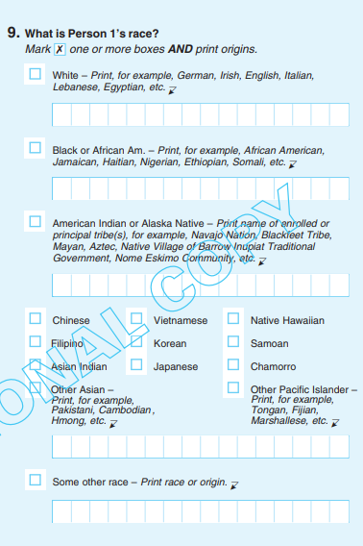
What is Person 1’s Race
Options: Mark one or more boxes AND print origins: White; Black or African American; American Indian or Alaska Native; Chinese; Filipino; Asian Indian; Vietnamese; Korean; Japanese; other Asian; Native Hawaiian; Samoan; Chamorro; other Pacific Islander; some other race.
Notes:
Confusing Question on the 2020 Census & Explanation

Slide 34
Is Person 1 of Hispanic, Latino, or Spanish origin?
Hispanic origins are not races.
Hispanic origin can be viewed as the heritage, nationality, lineage, or country of birth of the person or the person’s parents or ancestors before arriving in the United States. People who identify as Hispanic, Latino, or Spanish may be any race.
Options:
  No, not of Hispanic, Latino, or Spanish origin
  Yes, Mexican, Mexican Am., Chicano
  Yes, Puerto Rican
  Yes, Cuban
  Yes, another Hispanic, Latino, or Spanish origin - Print, for example, Salvadoran, Dominican, Colombian, Guatemala, Spaniard, Ecuadorian, etc.
Notes:
Confusing Question on the 2020 Census & Explanation

Slide 35
Is a person required to answer all of the census questions?
No. If you don’t answer all the questions, your form can still be submitted.
An enumerator may come to your house to collect the missing information.

Slide 36
There is NO citizenship question on the 2020 Census!

Slide 37
Track Your Community’s Progress!
The Benefits of An Online Census

Slide 38
2020 Census Self-Response Rate Map
Beginning on March 20, 2020 Census response rates will be available online in near real-time to help communities track their response rates.
  When partners/Complete Count Committees find self-response is lagging on the map, they can plan events or social media posts to encourage participation.
The Response Rate Map will be updated between 3pm and 4pm (EST) daily to reflect response rates from the prior day.
Response rates will be updated daily, 7 days per week, until the end of May 2020.
  From May to the end of July 2020, the map will be updated Monday – Friday only.
Notes:
Response Rates Info: https://2020census.gov/en/response-rates.html

Slide 39
Hard-To-Count “Census Tracts”
Hard-to-count populations are identified through looking at census tracts.
  Hardest to Count (HTC) Tracts are areas that had low response rates in 2010. So areas where mail return rates were 73% or less.
Census Tract are equivalent to a neighborhood established by the Bureau of Census for analyzing populations.
Tracts encompass a population between 2,500 to 8,000 people

Slide 40
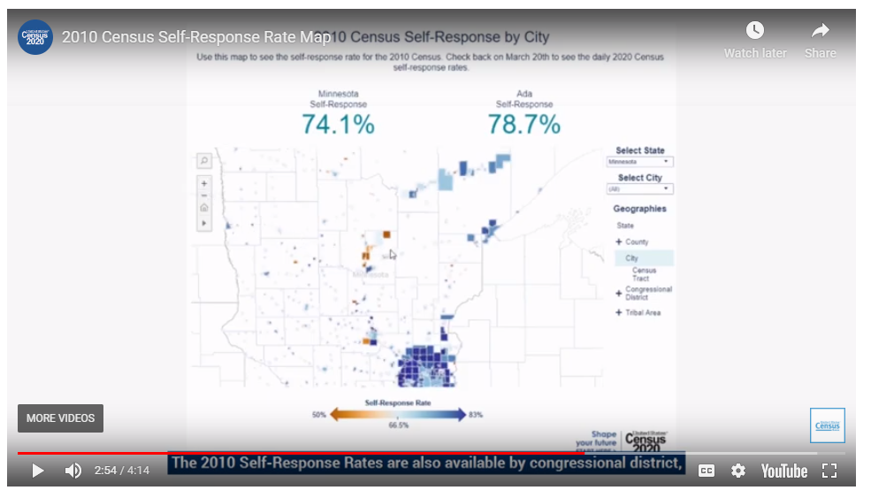
How to Use the Response Rates Map
Notes:
Additional Info: https://2020census.gov/en/response-rates.html

Slide 41
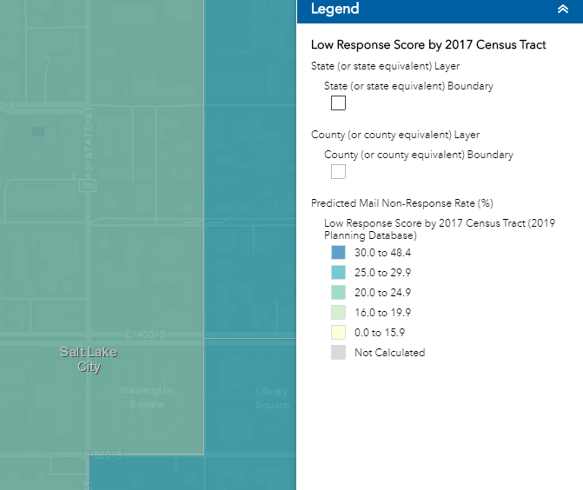
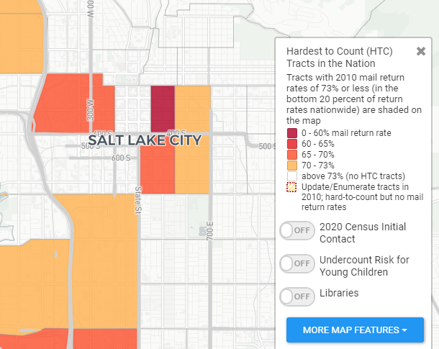
There are 2 map options to track response rates:
Census Bureau’s ROAM https://gis-portal.data.census.gov/arcgis/apps/webappviewer/index.html?id=3d16177a12b34c938adcf8c78e8b9699
HTC 2020 https://www.censushardtocountmaps2020.us/
Notes:
HTC 2020 map was developed by the CUNY Mapping Service at the City University of New York's Graduate Center. The Mapping Service, part of the Center for Urban Research, engages with foundations, government agencies, businesses, nonprofits, and other CUNY researchers to use spatial information and analysis techniques to develop and execute applied research projects.

Slide 42


SLC Counts Resources
For access to these resources email: hailey.leek@slcgov.com
Checkout: slc.gov/census or for Spanish: slc.gov/censo
Notes:
SLC will provide:
Signage
Copy of the questionnaire
Written instructions on how to gain access to online questionnaire
Written instructions on how to navigate through online questionnaire

