Slide 1
Notes:
Welcome and review agenda

Slide 2
Everyone counts equally in the Census- regardless of immigration status, income, age, race, or ability.
Notes:
There is a lot at stake for Utah in terms of how many seats we get in the U.S. House of Representatives to how much federal funding we receive to support our schools, hospitals and improve the safety of our roads.
The consequences of not counting everyone alters our views of the diversity of our City which impacts policy decisions and community development.

Slide 3
SLC Counts is working in partnership with the Census Bureau to ensure all residents are counted in the 2020 Census
SLC Counts is not in charge of conducting the census or hiring for census jobs.
Notes:
SLC Counts will focus on:
Strong community engagement to westside communities, students, undocumented individuals and young children
Providing accurate information and be a point of contact for questions and concerns

Slide 4
What is the Census?
The United States Census is a national survey conducted by the U.S. Census Bureau every 10 years to count the population.
It is your right and civic duty to participation in the census.
It is also required by law.
Notes:
The census counts people of all ages, races, religions and ethnic groups, including citizens and non-citizens.

Slide 5
Why the Census Matters
Critical decisions are made about YOU and your family at the federal, state, and local level based on census data.
If you’re not counted- you’re not represented.
Census results will impact Utah in three major ways...

Slide 6
Power
Census data determines:
Seats in the U.S. House of Representatives
Political districts and boundaries
Notes:
You being counted brings power to you and your community.
In the 2000 Census, Utah missed gaining a fourth seat in the U.S. House of Representative by just 80 people. We didn’t gain a fourth seat until 2010.
4th seat is now held by Congressman Ben McAdams (D).
The maps shows congressional districts

Slide 7
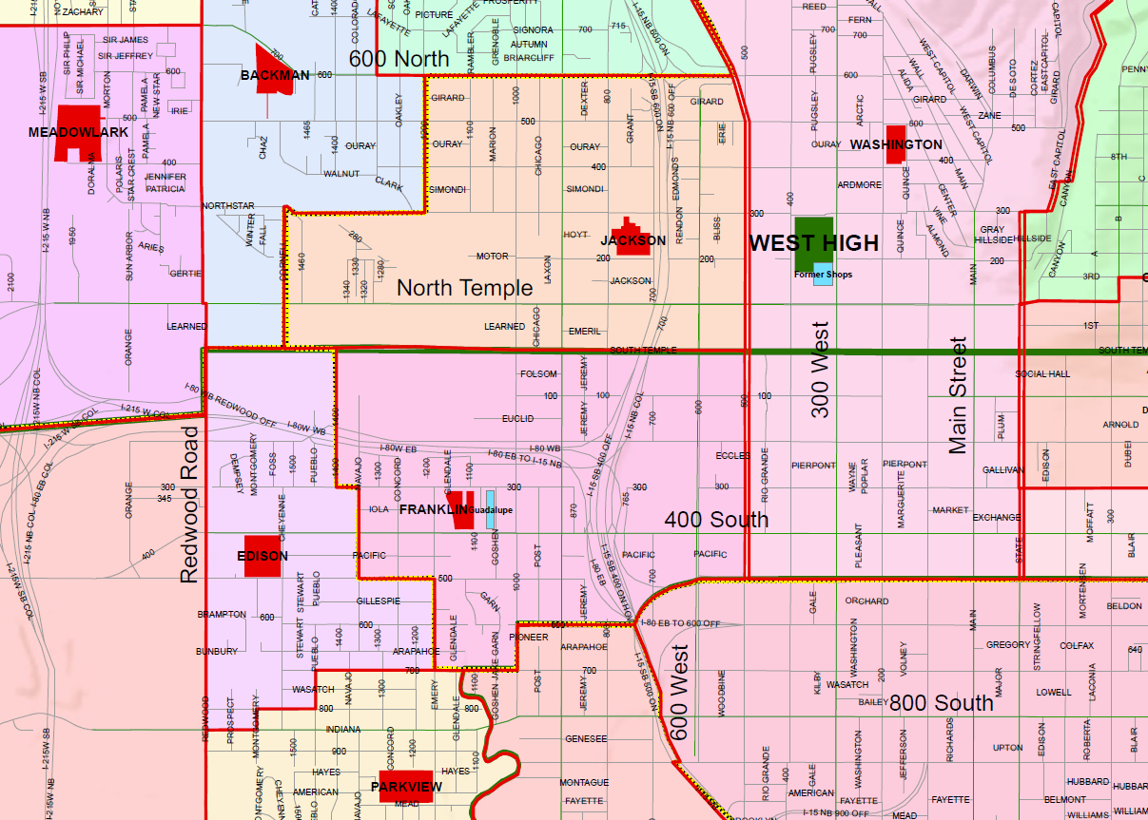
Access to Public Services
Census data determines where public services are built such as:
Schools
Hospitals
Roads
Child Care Centers
Senior Centers
Fire Stations
Notes:
How many public high schools are currently on the westside of Salt Lake City?
If you consider the westside of SLC- west of I-15, there are zero public high schools on the westside.
Students are bused to West, Highlight and East.
Census data is used to determine school boundaries.
Census data is critical to ensuring Utah’s students receive the support and resources needed to be successful in Pre-K through college.

Slide 8
Money
Utah receives $5.6 billion a year from the federal government.
.
Funding supports programs such as:
Medicaid
Highway Planning and Construction
National School Lunch Program
Head Start/Early Head Start
Child’s Health Insurance Program (CHIP)
Health Center Programs (Community, Migrant, Homeless, Public Housing)
Pell Grants for College
Supplemental Nutrition Assistance Program (SNAP)
Notes:
If you’re not counted - your community doesn’t receive it’s fair share of funding.

Slide 9
280,000 Utahns have the potential to be undercounted this Census.
Every person not counted is a loss of $1,086 per year over the next 10 years.
That’s $10,860 per person over ten years!
Notes:
That’s $10,860 per person SLC could use to improve roads, schools and our community.

Slide 10
Undercounted Populations
Undercounted Populations:
Immigrants
People of color
Children under 5 years old
Low-income households
People experiencing homelessness
Students
People living in apartments/renters
Federal Money
& Representation
Overcounted
Homeowners
Non-hispanic whites
Notes:
An undercount in the census means federal dollars and representation go to a smaller number of people.
Majority of the westside of Salt Lake is undercounted- and has the potential to be undercounted again in the 2020 census.
Undercounted populations have low census response rates because they’re hard to locate, hard to contact or hard to persuade to complete the census.

Slide 11
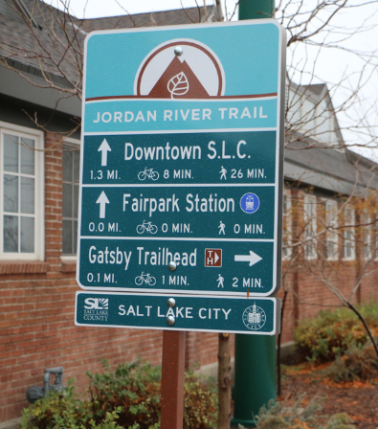
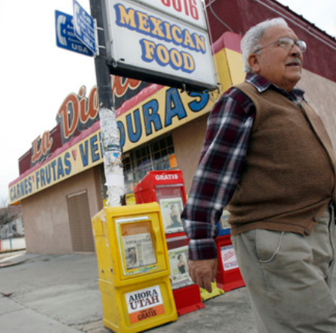
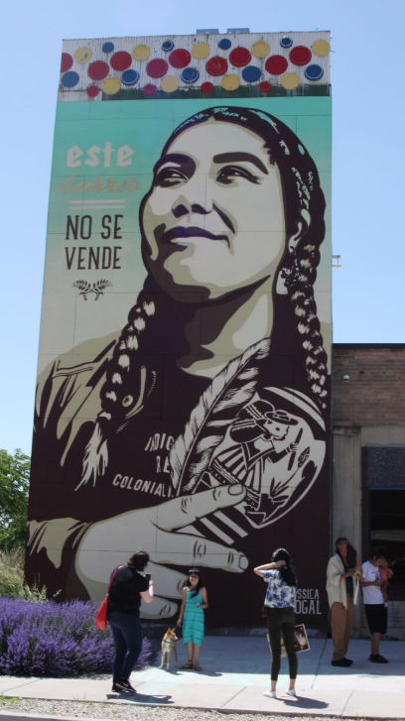
Census data must reflect our communities
Notes:
If one group gets more funding, the other gets less.
Businesses and government uses census data to plan where to build new businesses and service locations like grocery stores, clinics, schools and fire stations.
To receive fair representation and equal funding- communities must participate in the census.

Slide 12
How to Get Counted
Participate!
Step 1: Fill out the questionnaire either online, by mail, or phone
Step 2: Encourage family, friends, and neighbors to respond
Don’t want a knock on your door? Respond by April 1st!

Slide 13
Timeline
March 12, 2020 | Online and paper surveys and phone response begin
April 1, 2020 - Census Day! | Your answers to the survey should reflect what your household will look like on this day (where you will be living and with who)
April - May 2020 | If you haven’t responded yet - you will receive a reminder postcard and a paper survey
May 13 - July 24, 2020 | The Census Bureau will visit homes that haven’t responded to the survey
Notes:
March 12, 2020: Early Response
Online and paper questionnaires and phone response will be available.
April 1, 2020 - Census Day!
Your answers to census questions should reflect what your household will look like on this day (where you will be living and with who).
April - May 2020: Reminder
If you haven’t responded online yet - you will receive a reminder postcard and a paper questionnaire.
May 13 - July 24, 2020: Late Response
Home Visits - The Census Bureau will visit homes that haven’t responded to the questionnaire.

Slide 14
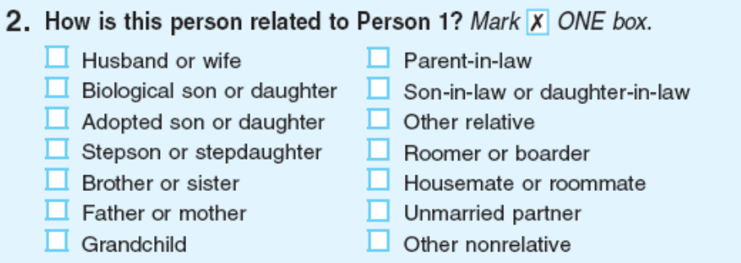
Census Questions
Name
Date of birth
Number of people living or staying in your house on April 1, 2020
Relationship of each person
Whether home is rented or owned
Sex
Age
Race
Hispanic, Latino, or Spanish origin
The census will NOT include a question on citizenship.
Notes:
Answers to these questions are central to implementing, monitoring, and evaluating civil rights laws and policies and anti-discrimination laws.
The Supreme Court blocked the Trump Administration from adding a citizenship question to the 2020 census.
Census data also helps predict new trends- like what families looks like in 2020: do kids live with their parents longers and are in-laws moving in.

Slide 15
What Languages are on the Census?
Paper Census Forms: English and Spanish
Online or by Phone: English, Spanish, Chinese (Mandarin, Cantonese), Vietnamese, Korean, Russian, Arabic, Tagalog, Polish, French, Haitian Creole, Portuguese, Japanese, Includes Telecommunication Device for the Deaf
Video and printed guides - Available in 59 non-English languages
Notes:
If a census takers knocks on a door and encounters a non-English speaker, they can show a language identification card that shows a short message in 59 languages.
After the resident identifies the language they speak, the field interviewer can take this back to the office to find an interpreter to either call or visit the home again.

Slide 16
Are my responses safe?
Yes!
Your information is legally protected by the United States Constitution.
Personal information can’t be shared with any court, government agency, law enforcement or Immigration and Customs Enforcement (ICE).
Notes:
Responses to the census are confidential and safe.

Slide 17
The Census Bureau will never ask for:
Social Security number
Bank or credit card account numbers
Money or donations
Anything on behalf of a political party
Any personal passwords
Your mother’s maiden name

Slide 18
Call to Action!
People are counting on you not to participate in the census. Filling out the census is a way to stand up and say no to discrimination
Encourage family, friends, and neighbors to complete the census
Share accurate and reliable information about the census on social media
Notes:
If you don’t count yourself- you’re invisible in the data for the next 10 years.
Every person we count in 2020 means more dollars going to your community.
We are all equally worthy of being counted, and our communities deserve to receive their fair shares of resources and representation.
Complete the Census before April 1st

Slide 19
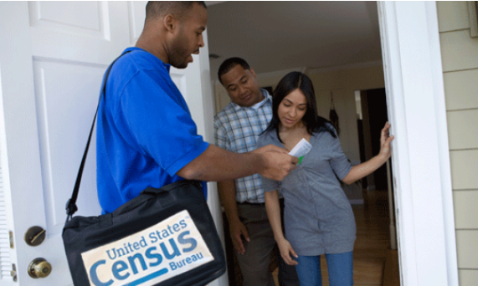
Census Bureau is hiring!
Flexible Hours
Pay begins at $17.00 per hour
Duties and Timeline
Census takers will go door-to-door to collect responses in person from households, nursing homes and dorms
Applicants will be notified in January or February, job begins in March
Looking for applicants who are bilingual in English and other languages spoken within their communities
APPLY NOW at 2020census.gov/jobs
Notes:
These positions offer flexible hours, paid training, and weekly paychecks
Perfect opportunity for students, retirees, and part-time or seasonal workers to earn some extra income while helping your community
Duties and Timeline
Supervisory positions will be filled in December, Census Takers in January with paid training starting in March
Although the work of most census takers won’t begin until March, apply now!

Slide 20
Questions?
Visit www.slc.gov/census or www.slc.gov/censo for more information
Email census2020@slcgov.com with questions
Notes:
www.slc.gov/censo is the Spanish version of the SLC Census website

Slide 21
References
Share accurate information from the following sources:
U.S. Census Bureau
NALEO (National Association of Latino Elected and Appointed Officials)
Asian Americans Advancing Justice
Count Us In 2020
Salt Lake City
Salt Lake County
State of Utah
Kem C. Gardner Institute

